Slide 1
Collections in Java

Slide 2
What is Collection in Java..?
- The Collection in Java is a framework that provides an architecture to store and manipulate the group of objects.
- Java Collections can achieve all the operations that you perform on a data such as searching, sorting, insertion, manipulation, and deletion

Slide 3
What is Framework..?
Framework is a collection of predefined classes and functions that is used to process input, manage hardware devices interacts with system software. It acts like a skeleton that helps the developer to develop an application by writing their own code.

Slide 4
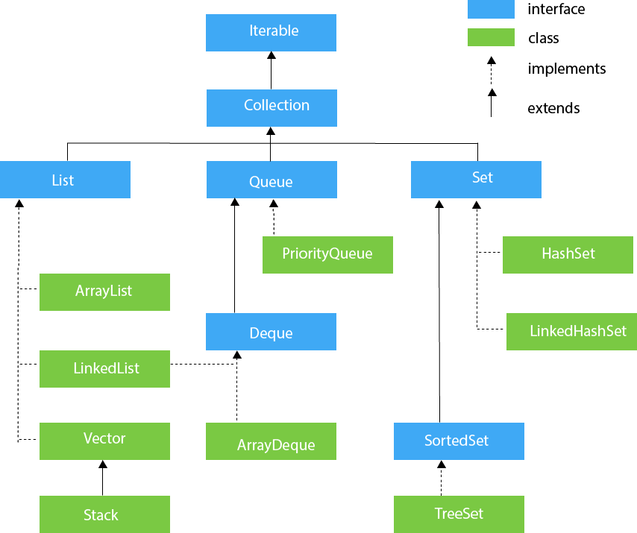
Hierarchy of the Collection Framework

Slide 5
Collection Interface
The Collection interface is the interface which is implemented by all the classes in the collection framework

Slide 6
Methods of Collection interface
No. | Method | Description
1 | public boolean add(E e) | It is used to insert an element in this collection.
2 | public boolean addAll(Collection<? extends E> c) | It is used to insert the specified collection elements in the invoking collection.
3 | public boolean remove(Object element) | It is used to delete an element from the collection.
4 | public boolean removeAll(Collection<?> c) | It is used to delete all the elements of the specified collection from the invoking collection.
5 | default boolean removeIf(Predicate<? super E> filter) | It is used to delete all the elements of the collection that satisfy the specified predicate.
6 | public boolean retainAll(Collection<?> c) | It is used to delete all the elements of invoking collection except the specified collection.
7 | public int size() | It returns the total number of elements in the collection.

Slide 7
8 | public void clear() | It removes the total number of elements from the collection.
9 | public boolean contains(Object element) | It is used to search an element.
10 | public boolean containsAll(Collection<?> c) | It is used to search the specified collection in the collection.
11 | public Iterator iterator() | It returns an iterator.
12 | public Object[] toArray() | It converts collection into array.
13 | public <T> T[] toArray(T[] a) | It converts collection into array. Here, the runtime type of the returned array is that of the specified array.
14 | public boolean isEmpty() | It checks if collection is empty.
15 | default Stream<E> parallelStream() | It returns a possibly parallel Stream with the collection as its source.
16 | default Stream<E> stream() | It returns a sequential Stream with the collection as its source.
17 | default Spliterator<E> spliterator() | It generates a Spliterator over the specified elements in the collection.
18 | public boolean equals(Object element) | It matches two collections.
19 | public int hashCode() | It returns the hash code number of the collection.

Slide 8
List Interface
- List interface is the child interface of Collection interface.
- List interface is implemented by the classes ArrayList, LinkedList, Vector, and Stack.

Slide 9
To instantiate the List interface, we must use
List <data-type> list1= new ArrayList();
List <data-type> list2 = new LinkedList();
List <data-type> list3 = new Vector();
List <data-type> list4 = new Stack();

Slide 10
STRING CLASS AND ITS METHODS
https://www.tutorialspoint.com/java/java_strings.htm
https://www.javatpoint.com/java-string

